Slide 1

Challenge Assessment 4 Control Theory
Rebecca Foster
Notes:
Hello everyone, my name is Rebecca and today I am presenting on my challenge assessment four for control theory

Slide 2
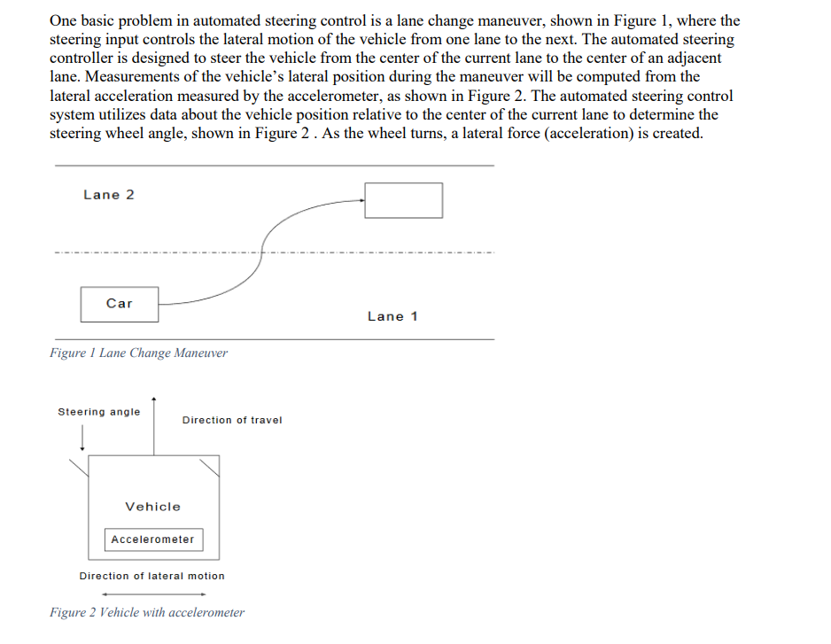
The Problem
Case 1
Simplified model w/ unity feedback
Case 2
Accelerometer Feedback Error
Notes:
So today we are dealing with the lane change maneuver of a self driving car. The goal of this project is to create a block diagram of the system, determine a gain K, and analyze the characteristic performance of the system. In case one we will be analyzing a simplified version of the system which ignores the dynamics of the actuator and only uses a steering angle of the car to its position. IN case two, we will be introducing an accelerometer which will be used to determine the lateral position of the car.

Slide 3
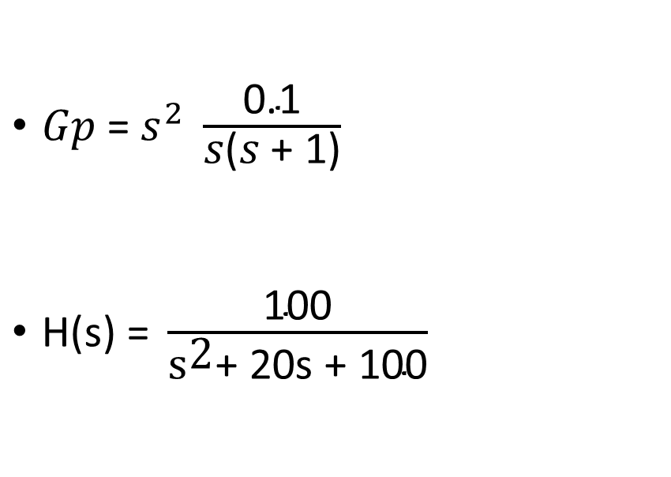
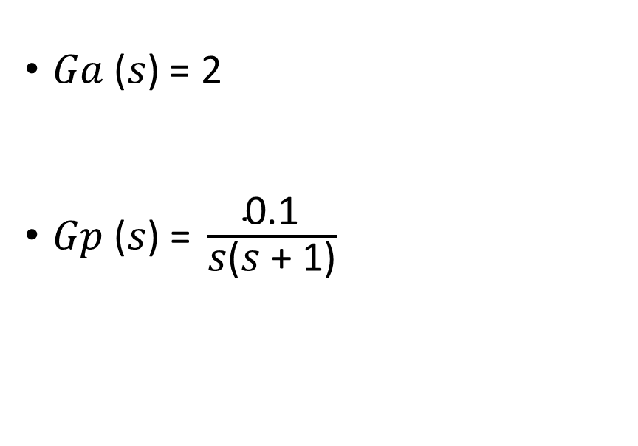
Differences Between Cases
Case 1
Case 2
𝐺𝑎 (𝑠) = 2
$\text{Gp}\text{ (}\text{s}\text{) = }\frac{\text{0.1}}{\text{s}\text{(}\text{s}\text{ + 1)}}$
$\text{Gp}\text{ = }s^{2} \frac{\text{0.1}}{\text{s}\text{(}\text{s}\text{ + 1)}}$
$\text{H}\text{(}\text{s}\text{) = }\frac{\text{100}}{{\text{s}}^{\text{2}}\text{+ 20}\text{s}\text{ + 100}}$
Notes:
So, due to the difference of complexity of the cases, the transfer function of each system is modeled differently as shown above.

Slide 4
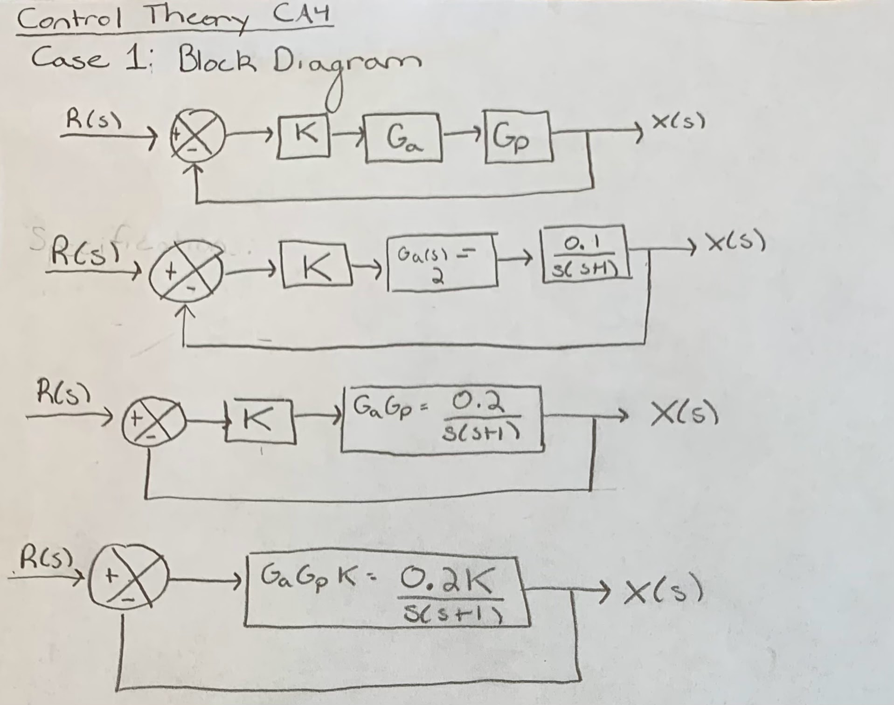
Case 1- Block Diagram & Simplification
Notes:
To begin, here is case one. R(s) is the desired position , it goes through a gain of K which we will determine later, then the actuator and the steering angle, which then is produced with its current position X(s). The signal throughout here is in distance so then we are able to feedback the signal to the system, so it knows where we are. Using block diagram math, we are able to simplify the system into a single block.

Slide 5

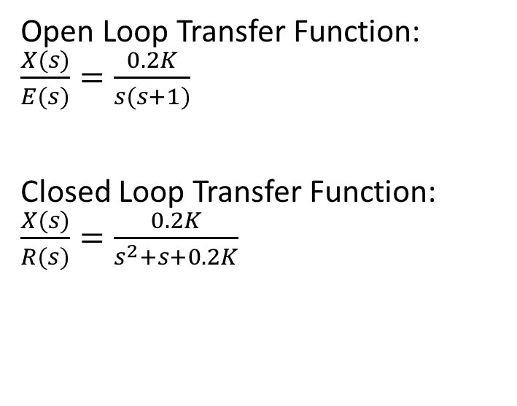
Case 1 Transfer Function
Open Loop Transfer Function: $\frac{X(s)}{E(s)}=\frac{0.2K}{s(s+1)}$
Closed Loop Transfer Function: $\frac{X(s)}{R(s)}=\frac{0.2K}{s^{2}+s+0.2K}$
Notes:
As a result we get our open loop transfer function which we are able to put into our negative feedback form to get the closed loop transfer function which we use to determine the characteristics of the system.

Slide 6
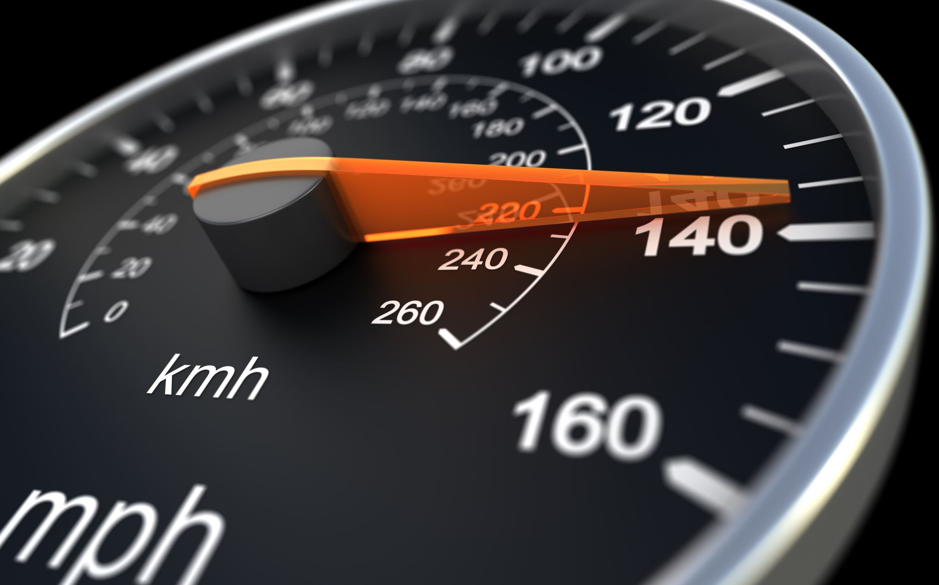
Performance Specifications for Case 1
Second Order System
Underdamped System
Notes:
So, due to the leading exponent of the bottom of the closed loop transfer function, we can tell this is a second order system. In addition, we are going to want this system to be underdamped. This is because we are going to want the car to execute its maneuver fairly quickly and due to the size of the lanes we can compromise with a little bit of overshoot. An undamped system causes way to much movement and swerving where as critically damped and overdamped take far to long to reach the desired lane change.

Slide 7
MatLab Code for Case 1
%CA 4;
%Case 1;
K= 2; %Chosen
wnsquared = 0.2*K;
Wn = sqrt(wnsquared);
Zeta = 1/(2*Wn); %Needs to be less than one and greater than zero
num = wnsquared;
den = [1, 1, 0.2*K];
sys = tf(num, den);
figure(1)
step(sys);
Theta = acos(Zeta);
Wd = Wn*sqrt(1-(Zeta)^2);
RiseTime = (pi - Theta)/Wd;
PeakTime = pi/(Wd);
SettlingTime = 4/(Zeta*Wn);
Overshoot = exp(-1*Zeta*Wn*(pi/Wd));
Kp = dcgain(sys);
ess = 1/(1+Kp);
T = feedback(sys,1);
poles = pole(T);
Notes:
This is the code I used to help determine the K value. To do so I ran the code several times and picked different values for each run and then compared each value To note, since we are trying to design a underdamped system, we want zeta to be less than one and greater than zero.

Slide 8
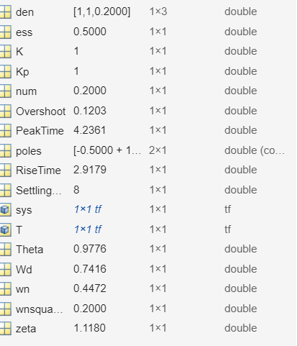
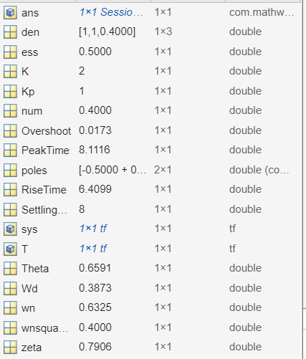
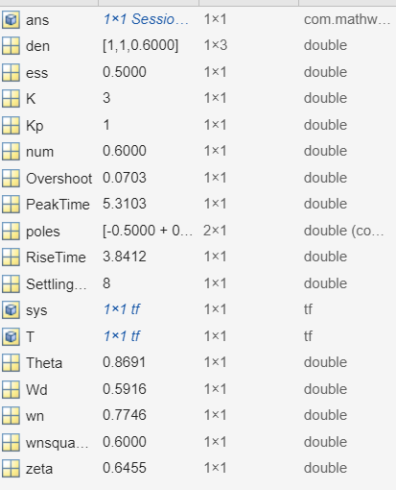
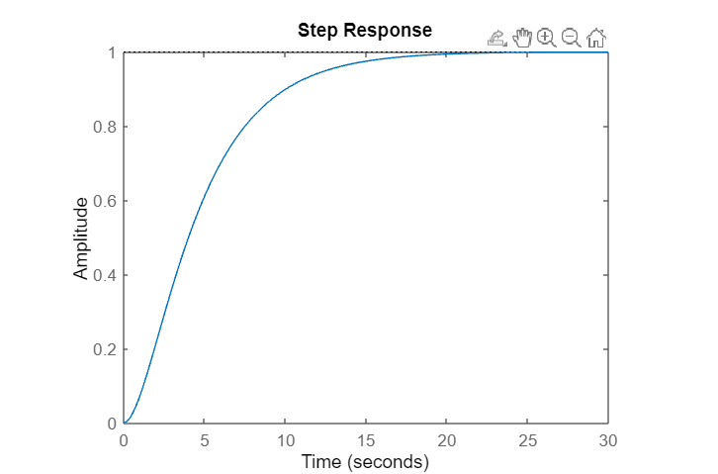
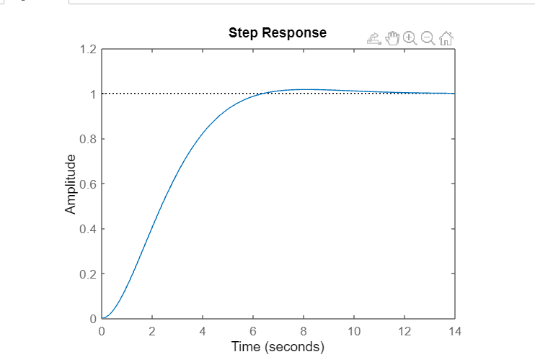
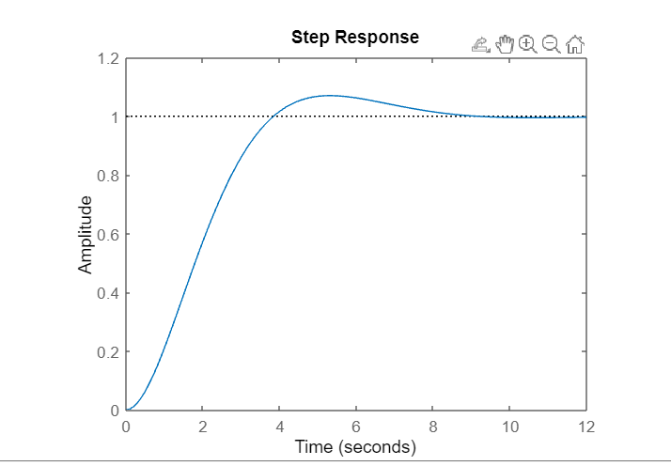
Comparison of K Values
Notes:
So this is some of the K values I tested. I noticed as I got higher than three there was way more overshoot, so I am just displaying the top three contenders. Number one actually isn’t an underdamped system because zeta is greater than one which makes it overdamped. In addition, because zeta is greater than one, then the values for rise time is incorrect because to find theta I used the arc cos of zeta, however the range for arccos has to be between -1 to 1. However, looking at the graphs I decided to go with the middle one. It does take longer for it to reach the desired time, but it is still in an acceptable range and there isn’t as much overshoot as there are in higher gains.

Slide 9
Case 1 System Performance Characteristics K=2
Rise Time | 6.41s
Settling Time | 8 s
Peak Time | 8.12 s
Overshoot | 1.73%
Steady State Error | 50
System Type | 0
Static Error Constant | 1
Stability (Pole Location) | -.5 +/- .4i
Notes:
So using a gain of two, these are the performance characteristics I calculated. Rise time, which is the time it takes for the response to reach its final value is about 6 and a half seconds. I think this is about the right amount of time it takes for a car to get over without causing all of the people within the car to be swung around as well as give other drivers time to get out of the cars way or at least realize it is getting over. Next is the settling time which is the time it takes for the response to be within a certain percentage of its final value. For this system it takes about eight seconds, which is pretty good. Long enough to not jostle anyone but quick enough to not annoy other drivers on the road and cause any accidents. The peak time, which is the time required to hit its first overshoot is about the same, meaning there is not much overshoot and it quickly goes into the position it needs. You can see this in the next quality which is overshoot which is less than two percent. So it isn’t exact but not far off the goals which given lane size is a good thing. The steady state error I got was 50 percent. This is because I took this system as a step system because we are talking about lateral movements. It is also a system type zero, so to determine the state error constant you take the limit of the transfer function as s approaches zero. From that I got one and using the step input equation for system type zero I got .5 or 50 percent. This seems to be a bit much but through redesign or using a compensator this can be reduced. Finally, I checked the stability of the system. SO both poles are on the left side of the plot, which means that it is a stable system as the natural input as s approaches infinity is zero.

Slide 10
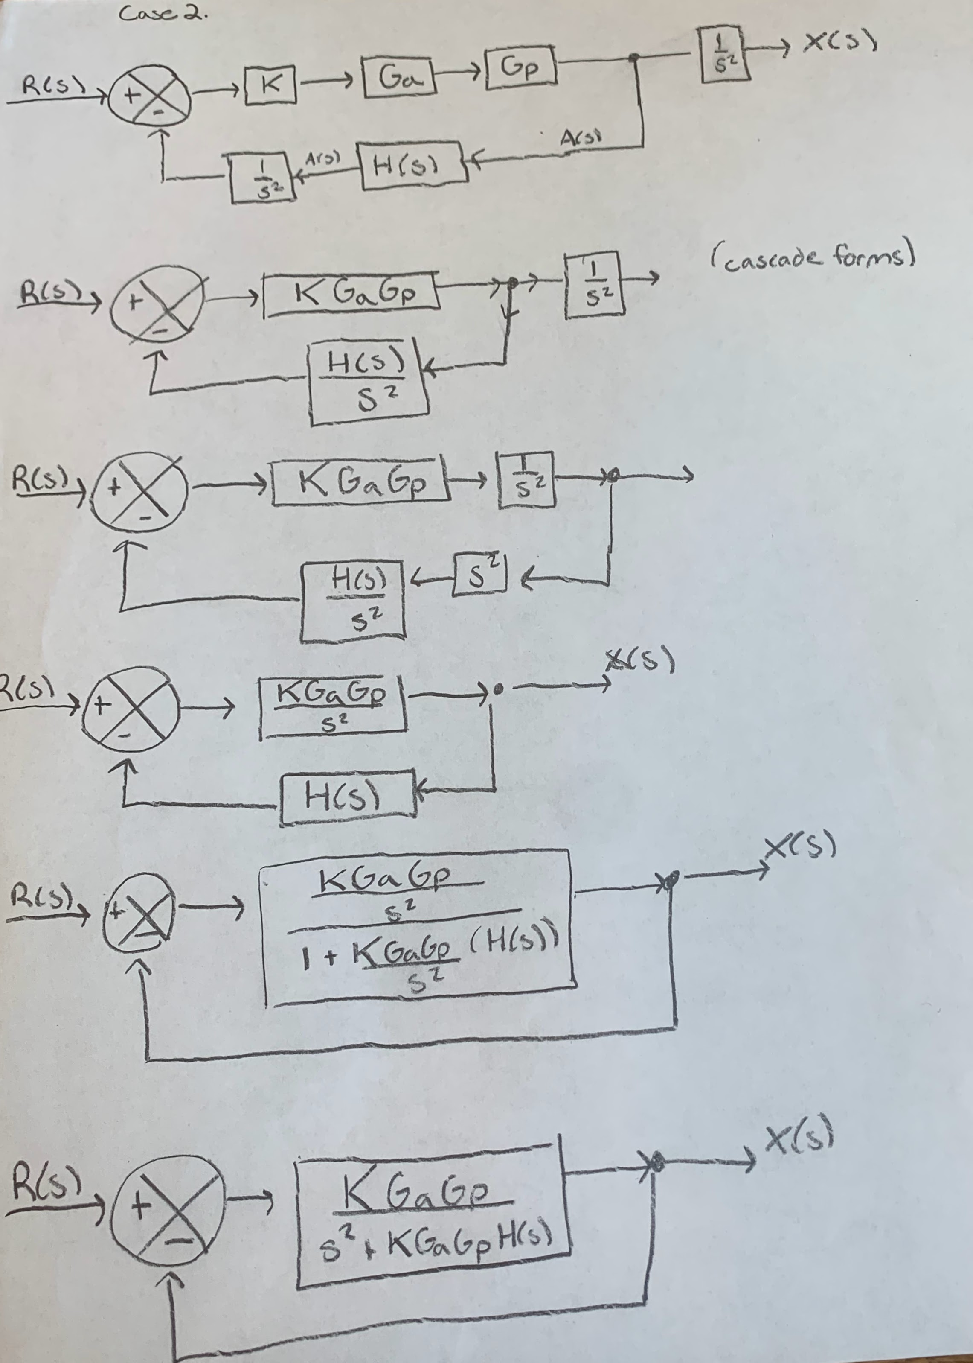
Case 2- Block Diagram & Simplification
Notes:
Now we move onto the more complicated case two. In this problem we determined lateral position via an accelerometer whose signal is acceleration. So in this case we had to go from a acceleration signal back to a position, hence the extra one over s squared boxes. Once I determined this I was able to again simplify this into a negative feed back form with unity feedback.

Slide 11
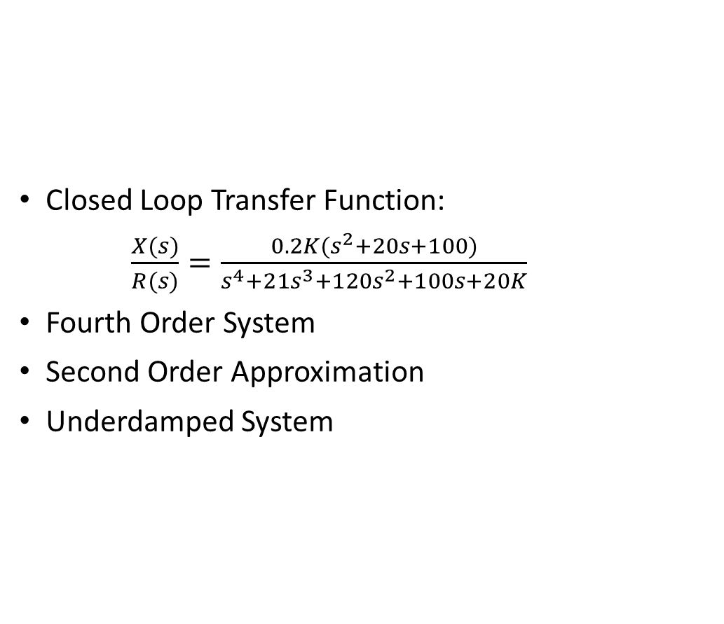
Case 2 Transfer Functions & Performance Specifications
Closed Loop Transfer Function:
$\frac{X(s)}{R(s)}=\frac{0.2K(s^{2}+20s+100)}{s^{4}+21s^{3}+120s^{2}+100s+20K}$
Fourth Order System
Second Order Approximation
Underdamped System
Notes:
From that I was able to get the closed loop transfer function. This is a fourth order system, as indicated by the leading coefficient in the denominator. IN addition, as you will see in the next few slides, we are able to use a second order approximation on this system as two of the poles are more than five time constants away from the initial two pair. Again, we are wanting an underdamped system so that the car is able to quickly move into the lane change maneuver with smaller overshoot.

Slide 12
MatLab Code for Case 2, K = 2
%CA 4;
%Case 1;
K= 2; %Chosen
Sigma = 0.5; % From the poles
wnsquared = 0.2*K;
Wn = sqrt(wnsquared);
Zeta = Sigma/Wn; %Needs to be less than one and greater than zero
num = wnsquared;
den = poly([1, 1, 0.2*K]);
sys = tf(num, den);
T = feedback(sys,1);
poles = pole(T);
figure(1)
step(sys);
Theta = acos(Zeta);
Wd = .742; %From the poles
RiseTime = (pi - Theta)/(Wd);
PeakTime = pi/(Wd);
SettlingTime = 4/(Zeta*Wn);
Overshoot = exp(-1*Zeta*Wn*(pi/Wd));
Kp = dcgain(sys);
ess = 1/(1+Kp);
Notes:
So again this is the matlab code I used for this case. I used the gain value determined from the previous case. Some noticeable differences from this case compared to the previous one is that I first ran the code to determine the pole locations (with help from Dr. Romatoski), Initially I assumed because we were making a second order approximation I could just reuse the old code with the new transfer function, however, that is not correct as I was just getting the exact same values as before. So instead I took the poles of the pair closer to the y axis to determine the omega d and sigma values and from there I was able to determine the performance characteristics.

Slide 13
Case 2 System Performance Characteristics
Rise Time | 2.76 s
Settling Time | 8.80 s
Peak Time | 4.12 s
Overshoot | 19%
Steady State Error | 50%
System Type | 0
Static Error Constant | 1
Stability (Pole Location) | -10 +/- .66i & -.46 +/- .76i
Notes:
So these were the performance characteristics for the system. I have a comparison on the next slide but some notable things is that the steady sate error did not change for the same reason as the previous case, as well as it is a system type zero as there are no poles located at zero. Going through all of those calculations again gives us a static error constant of one. Now we have our stability, As I mentioned previously, the two sets of poles are far removed from each other which gives us the second order approximation. In addition, All of the poles are negative which indicates a stable system.

Slide 14
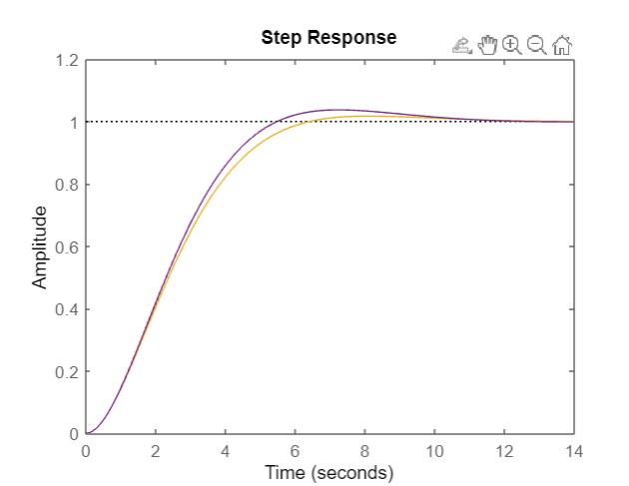
Comparison of Case 1 & Case 2
Characteristic | Case 1 | Case 2
Rise Time | 6.41s | 2.76 s
Settling Time | 8 s | 8.80 s
Peak Time | 8.12 s | 4.12 s
Overshoot | 1.73% | 19%
Steady State Error | 50 | 50%
System Type | 0 | 0
Static Error Constant | 1 | 1
Stability (Pole Location) | -.5 +/- .4i | -10 +/- .66 & -.45
Notes:
So here is our comparison for the case one and two. As you can see the rise time was decreased a pretty good amount as well as the peak time. However in return we have a much larger overshoot. With testing we can see if this is still within an acceptable range. If it is, a compensator can be added to decrease the overshoot. Settlining time was pretty much the same, still a good time to be around. And then the system types, static errors, were the same because they were both a type zero system on a step input whose transfer functions canceled to be one in the same way. On the right is a figure of the system with case two being the purple line and case one being the yellow. Thank you all for your time!

